Slide 2
https://www.youtube.com/watch?v=NQrH_vEnxz8
Notes:
Intro video text:
Rachel de Souza, Children’s Commissioner for England: Hello. My name is Rachel de Souza, and I'm the Children's Commissioner for England. And it's my job to listen to you and to make sure your voice is heard. I've been asked by the government to carry out a review of family life.
This is a really exciting project that will help us understand what families and family life are like in the 21st century. And it's also an opportunity for me to put children and young people's voices at the heart of government policy.
Last year, I launched The Big Ask, the largest ever survey of England's children with the help of this young man. Thank you, Marcus. We've got over half a million responses from England's children. And you told me just how important family is to you.
And families, you told me, come in all shapes and sizes. There is no one size fits all.
Girl 1: So there's five of us, which is me, my dad, my mum, my brother and my twin sister. And we also have two dogs which are beagles called Oscar and Poppy.
Girl 2: The household I'm living in right now is with my mum and my mum's boyfriend, but I'm still in contact with like my aunts and uncles and cousins and grandparents.
Girl 3: There's my mum and my older sister and my younger brother and my cat called Winnie.
Girl 4: I have my sister, my mum, my mum's boyfriend, my dad, my nan and my grandad.
Boy 1: Well, the people in my family are my mum, my dad and my, hang on, five brothers and my one sister.
Boy 2: I have a baby brother, an older brother, my younger sister and two of my parents who I love very much.
Rachel de Souza, Children’s Commissioner for England: So, my family means the world to me. I grew up with my mum and my dad and my three brothers, and I'm still really close to all those brothers now. And I was very close to my grandma as a little girl.
She was a refugee from Hungary and meant the world to me. Now I've got my own family, my husband, my grown up son, and all my nieces and nephews. Now, that's my family. I want to hear about your family.
And what does family mean to you?
Boy 3: Family means to me spending time and just being together and when you get that nice feeling of you're all together and communicating and having a nice time, it's a kind of golden buzz.
Girl 5: Family means to me, happiness. And while I get to call my mum a lot, but sometimes I'm sad because I don't get to see her in person.
Boy 2: It doesn't have to be like a blood connection. You can be like friends with someone. You can see them as family. They have to be someone who you love dearly and that you'd do anything for.
Boy 1: Family means to me is the people I love and the people who love me.
Girl 1: It means love, having fun and spending time together.
Girl 3: Well, family means to me a fun bonding place that you can just talk to people and just have as much fun as you possibly can.
Rachel de Souza, Children’s Commissioner for England: If we can help the Government understand what modern families are like, it will be much easier for it to make the best decisions to keep families strong and happy.
So, we also want to know what you like to do with your family and what makes your family happy.
Girl 4: I like to spend time with my family by maybe like going swimming, having a weekend out, maybe just staying in, having just a relaxed day.
Boy 3: We like to spend lots of time outdoors and we like being together. And despite some arguments, we always tend to get along by the end of the day.
Boy 4: My grandad takes me to his old RAF radio station.
Boy 2: I like to spend time with my family, with my step dad, my sister and my brother. Sometimes we just play a board game or we just go watch a movie, or we go out just to feel that togetherness with each other.
Boy 1: Sometimes going to the beach in Great Yarmouth and having fun at the arcades.But sometimes we just have a family film night, which is also really fun.
Boy 3: We get along as a family listening to music and we share that interest and we like going out and listening to different bands and that always makes us feel quite happy.
Boy 1: Sometimes I go to my older brothers for advice and they are really good. They're really good at helping me, and when I'm down I just have a little chat with them and it always cheers me up.
Girl 3: Sometimes we just love each other, cuddle and tell jokes.
Boy 2: What makes me happy is that we all have each other's back and no matter what it can be with someone I'm related to or someone that I just see as family due to our connection, that we will stand by each other in any type of situation.
Rachel de Souza, Children’s Commissioner for England: So I've sent an activity pack to your school with lots of tasks for you to do with your classmates. You might be asked to draw a picture of your family, or how your family fits together, or your teacher might ask you to write something instead or take part in other activities.
All of this will help me understand what family means to children and young people and what your family life is like. I hope we can get everyone talking about family. It's so important that Government hear what you think about family and what your family's like.
This is your chance to get involved. Thank you.

Slide 3
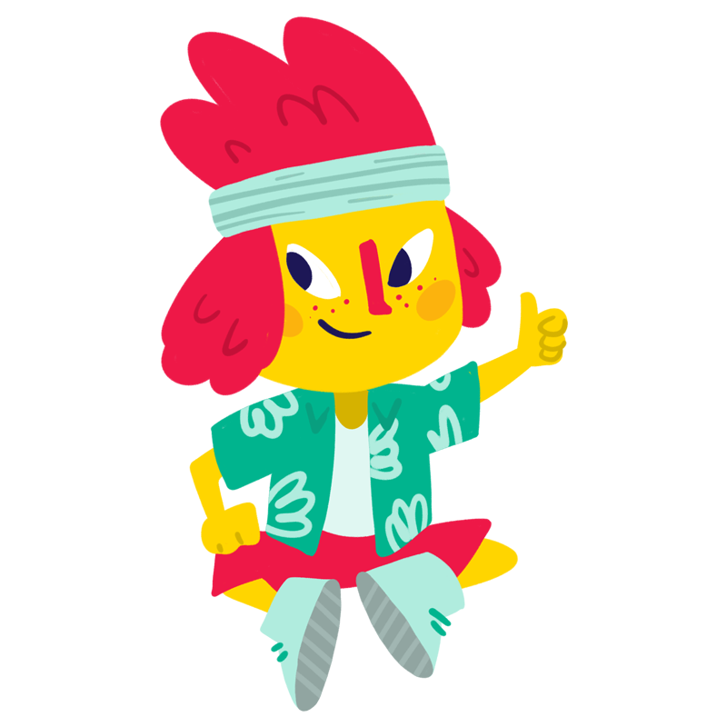
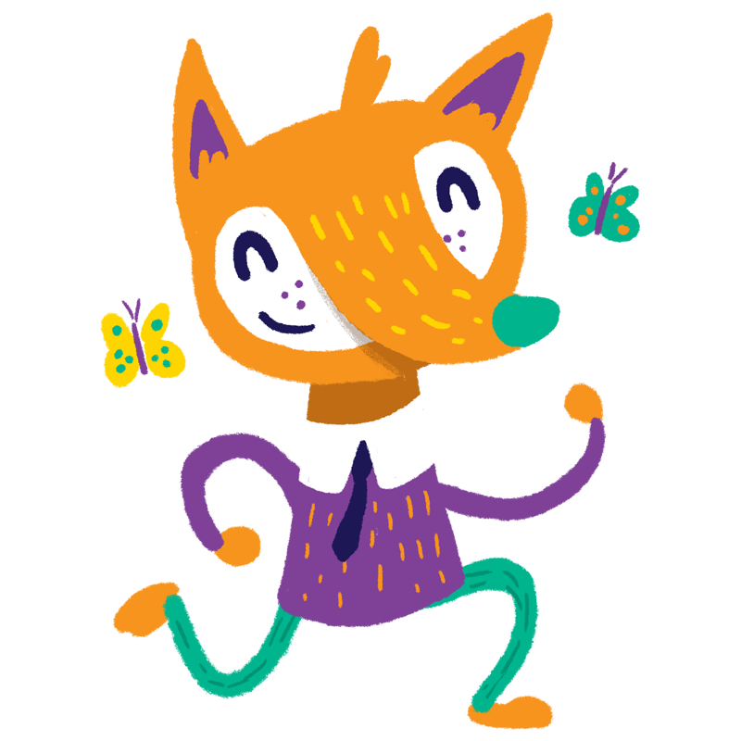
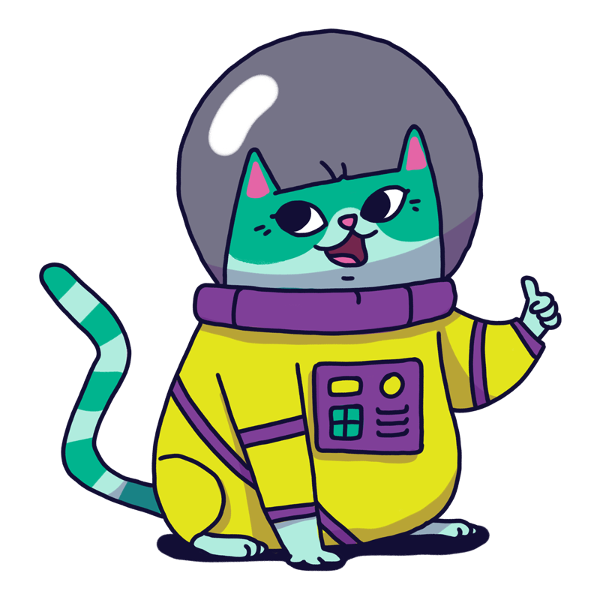
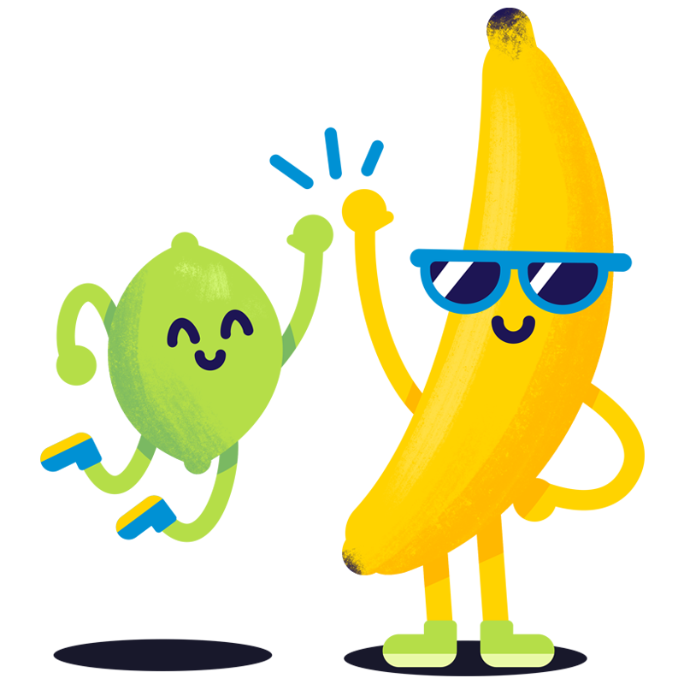
Have your say!
The Children’s Commissioner has been around England talking to you about how important family is and how much time with family really matters.
She now wants to know how you spent time with you family over the summer break and if there is anything that could have made your summer better.
Take part in the survey here
Notes:
LINK TO SURVEY: https://www.childrenscommissioner.gov.uk/tbss/

Slide 4
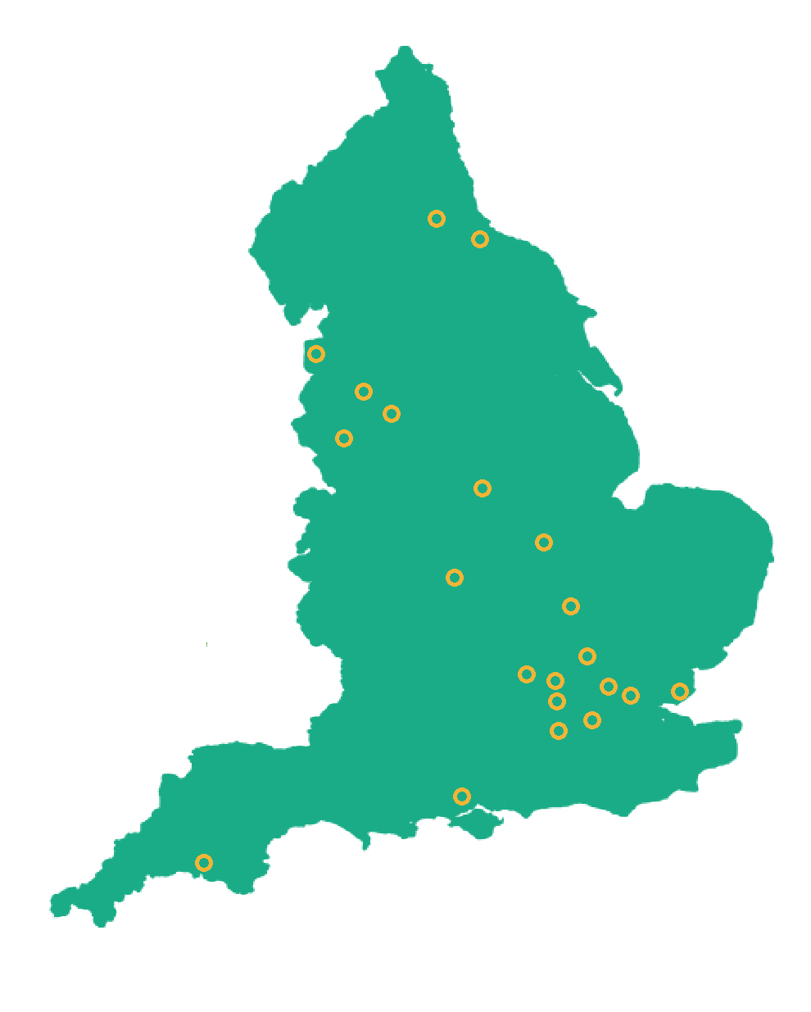
The Family Review
Over the past 6 months the Children’s Commissioner has been looking into family life.
She has spoken to children across England and has found out facts about families and who you consider part of your family.
Importantly she has found out just how much family means to you and is looking at what can be done to enhance family life.
She also looked at the differences in family life due to the COVID-19 pandemic.

Slide 5
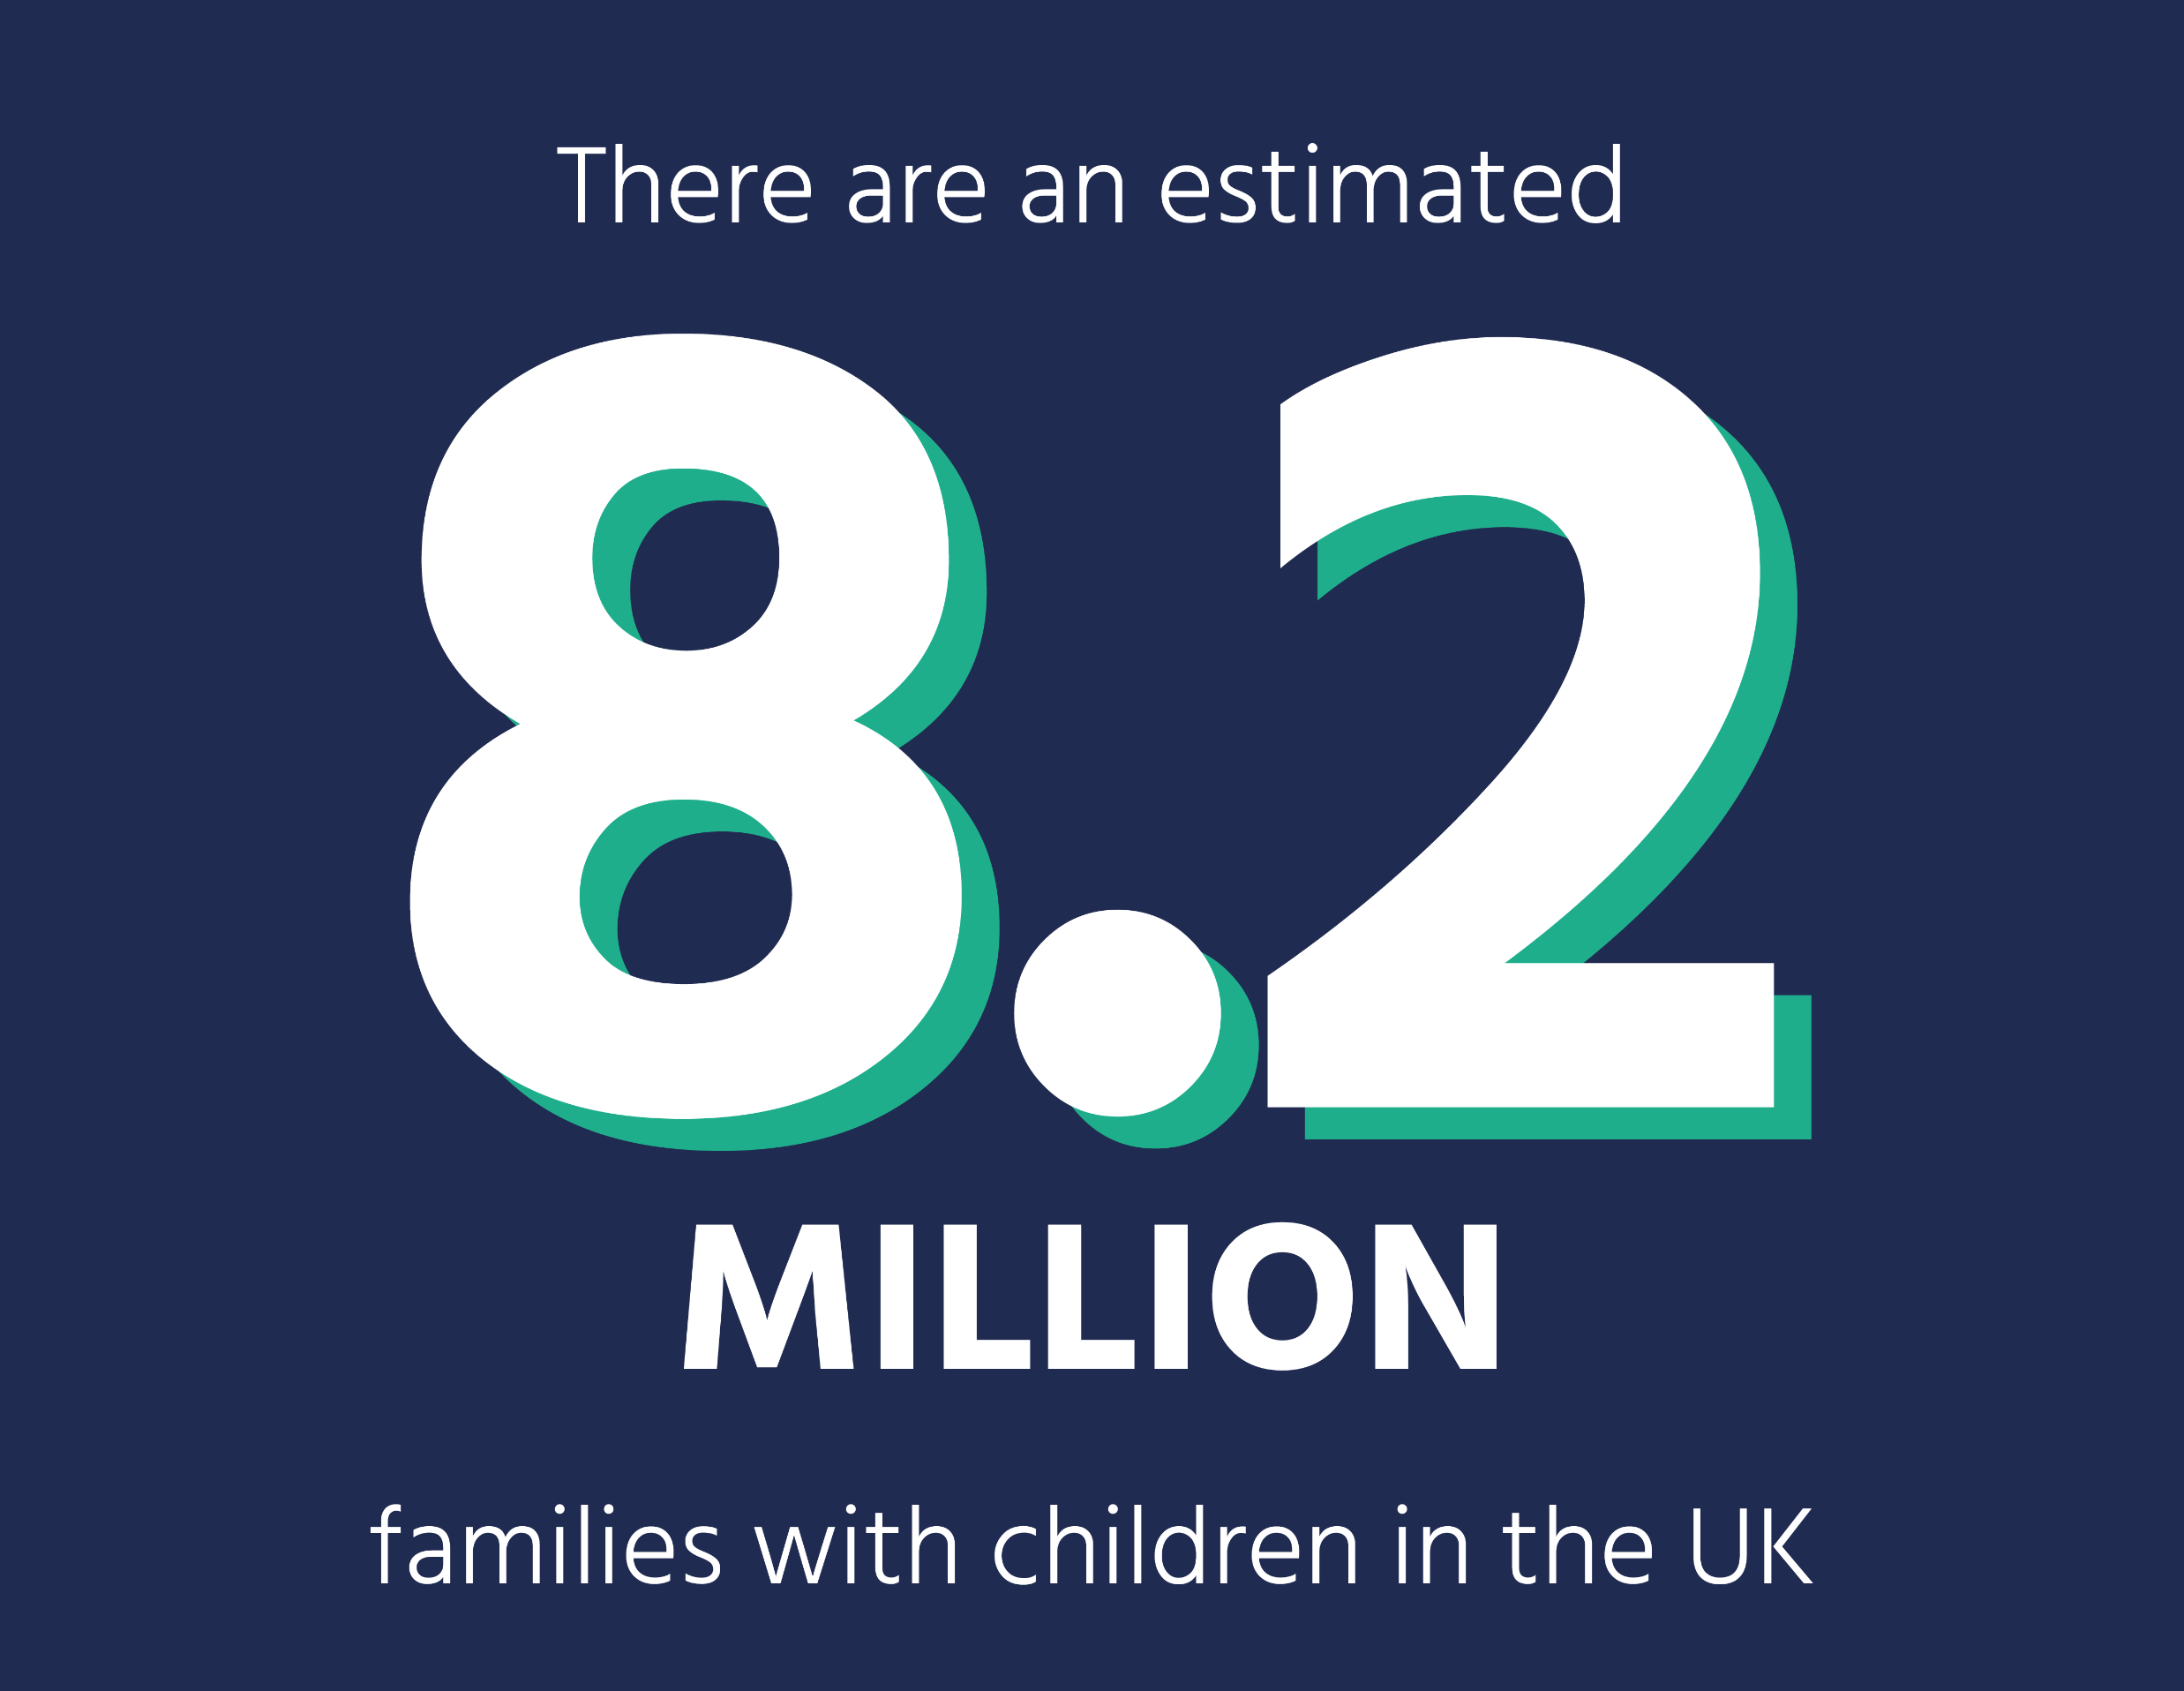
Family in the UK and England in 2022
63% of families are married couples with children
14% of families are couples who are not married with children
23% of families have single parents
Notes:
42% of families have one child, 42% of families have two children, 15% of families have three or more children
42% of families have two children
15% of families have 3 or more children

Slide 6
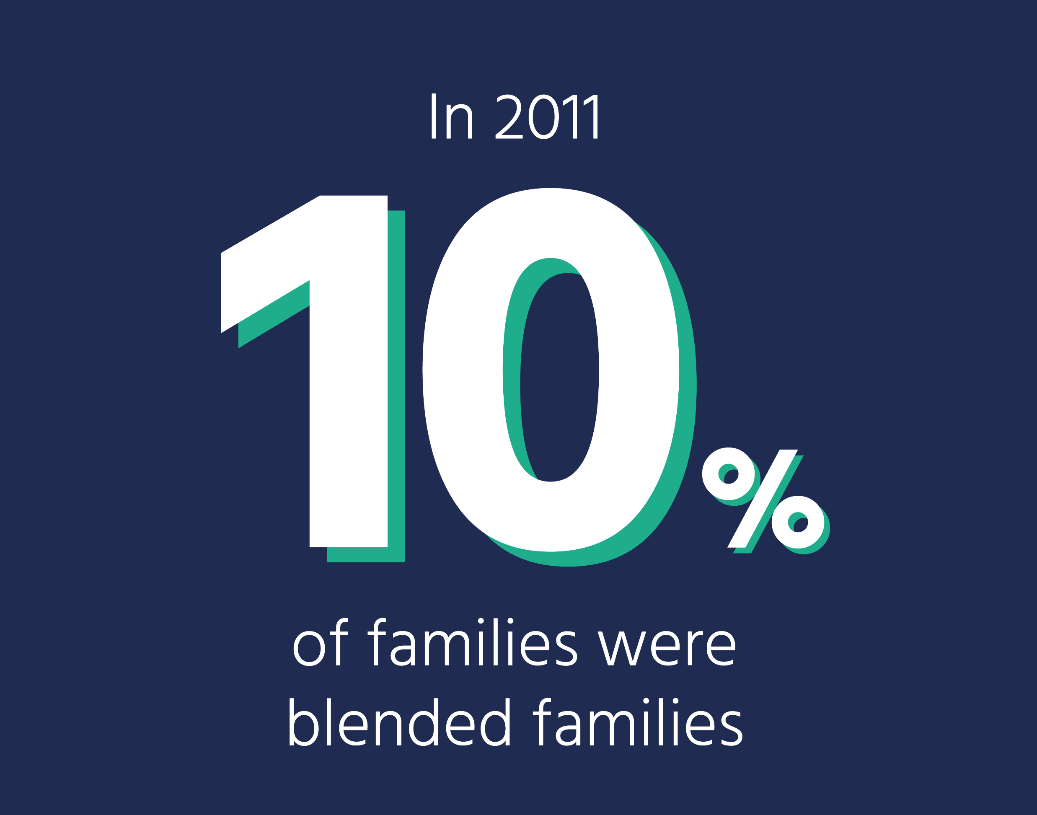
Families come in all shapes and sizes
About one in ten families are 'blended' which means that children live with at least one step-parent.
Parents separating is quite common, but parents can get back together, or form new relationships.
In our survey of family life, nearly a quarter of children don't live with both of their parents in their main home.

Slide 7
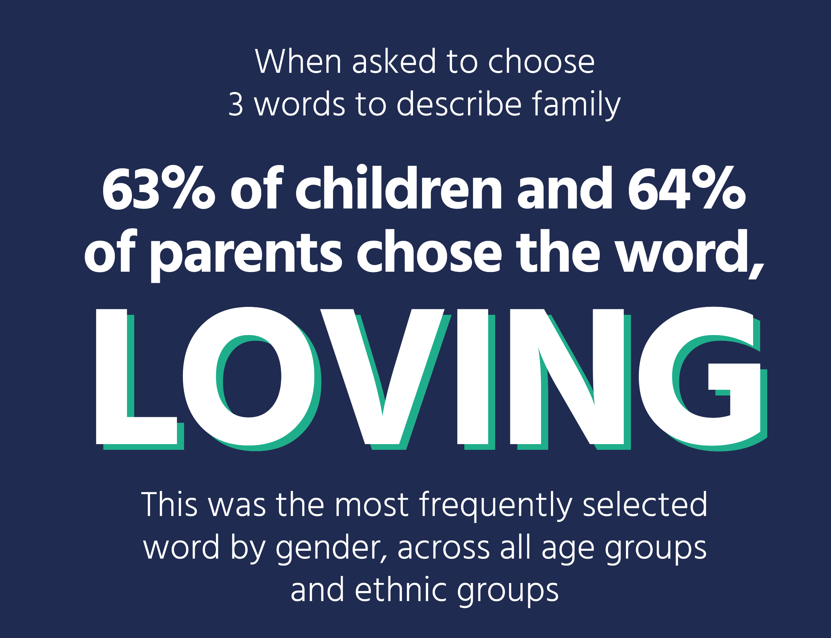
Families across the country were united in how important they thought family was to their lives

Slide 8
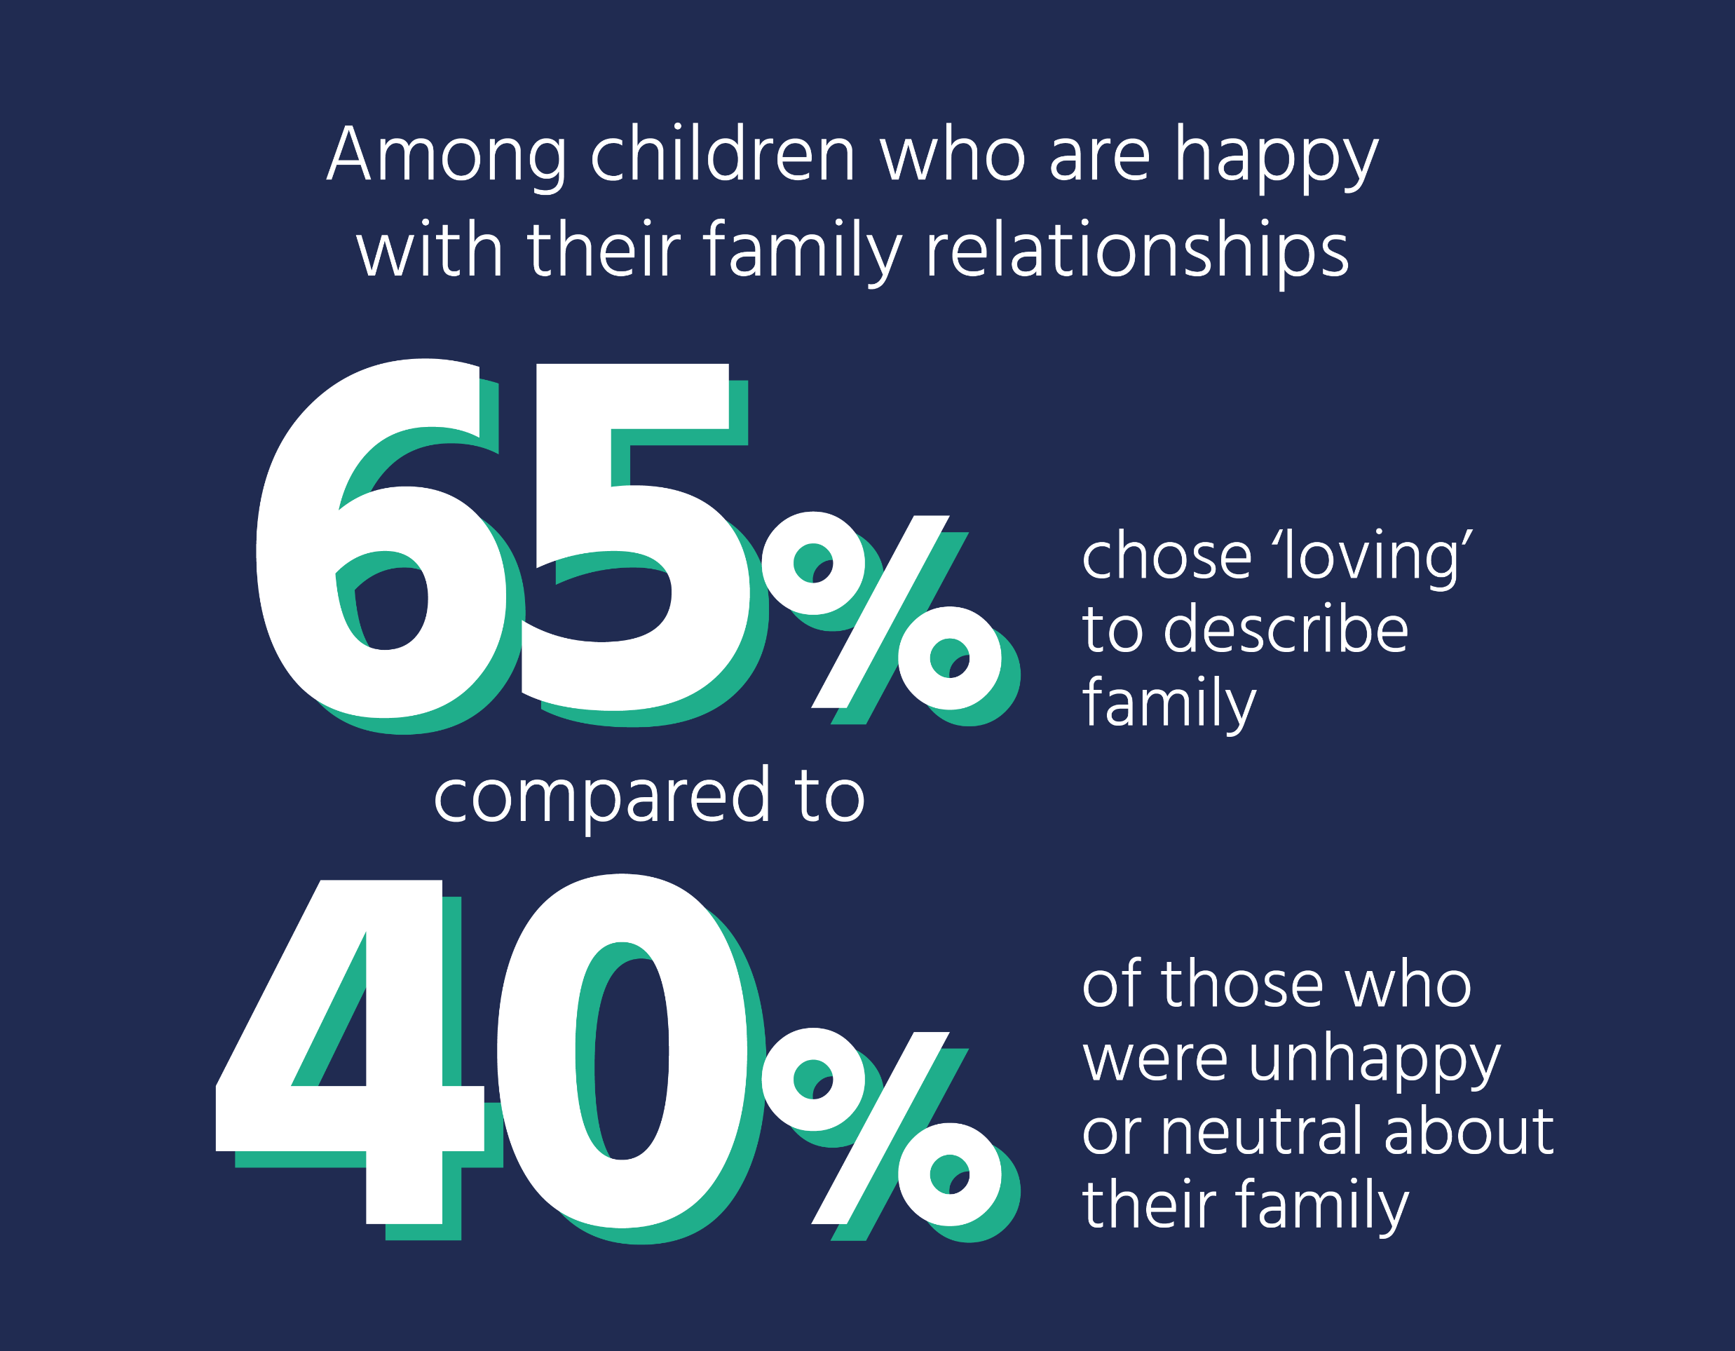
Good family relationships are important to children's happiness
Notes:
Getting on very well with either of your parents at age 13 is associated with higher wages at age 25
75% of parents are satisfied with life overall when their family regularly eats dinner together, compared to 70% of parents when their family doesn’t regularly eat dinner together
80% of those who can rely on their family ‘a lot’ if they have a serious problem are satisfied with life overall, compared to 66% of those who cannot rely on their family ‘a lot’.
Key challenges to family are:
Financial pressures and the cost of living
Childcare
Bad family relationships
Twelve percent of children see their parents angry and fighting.
Fights about money and chores around the house are among the biggest reasons for family conflict as they can add to stress.
These children are more likely to have lower confidence, may do worse at school, find it difficult to make friends and may become anxious.
Family relationship problems are the most common problem in the NHS’ therapy services for young people. Out of 42,000 children, over half had family relationship problems..

Slide 9
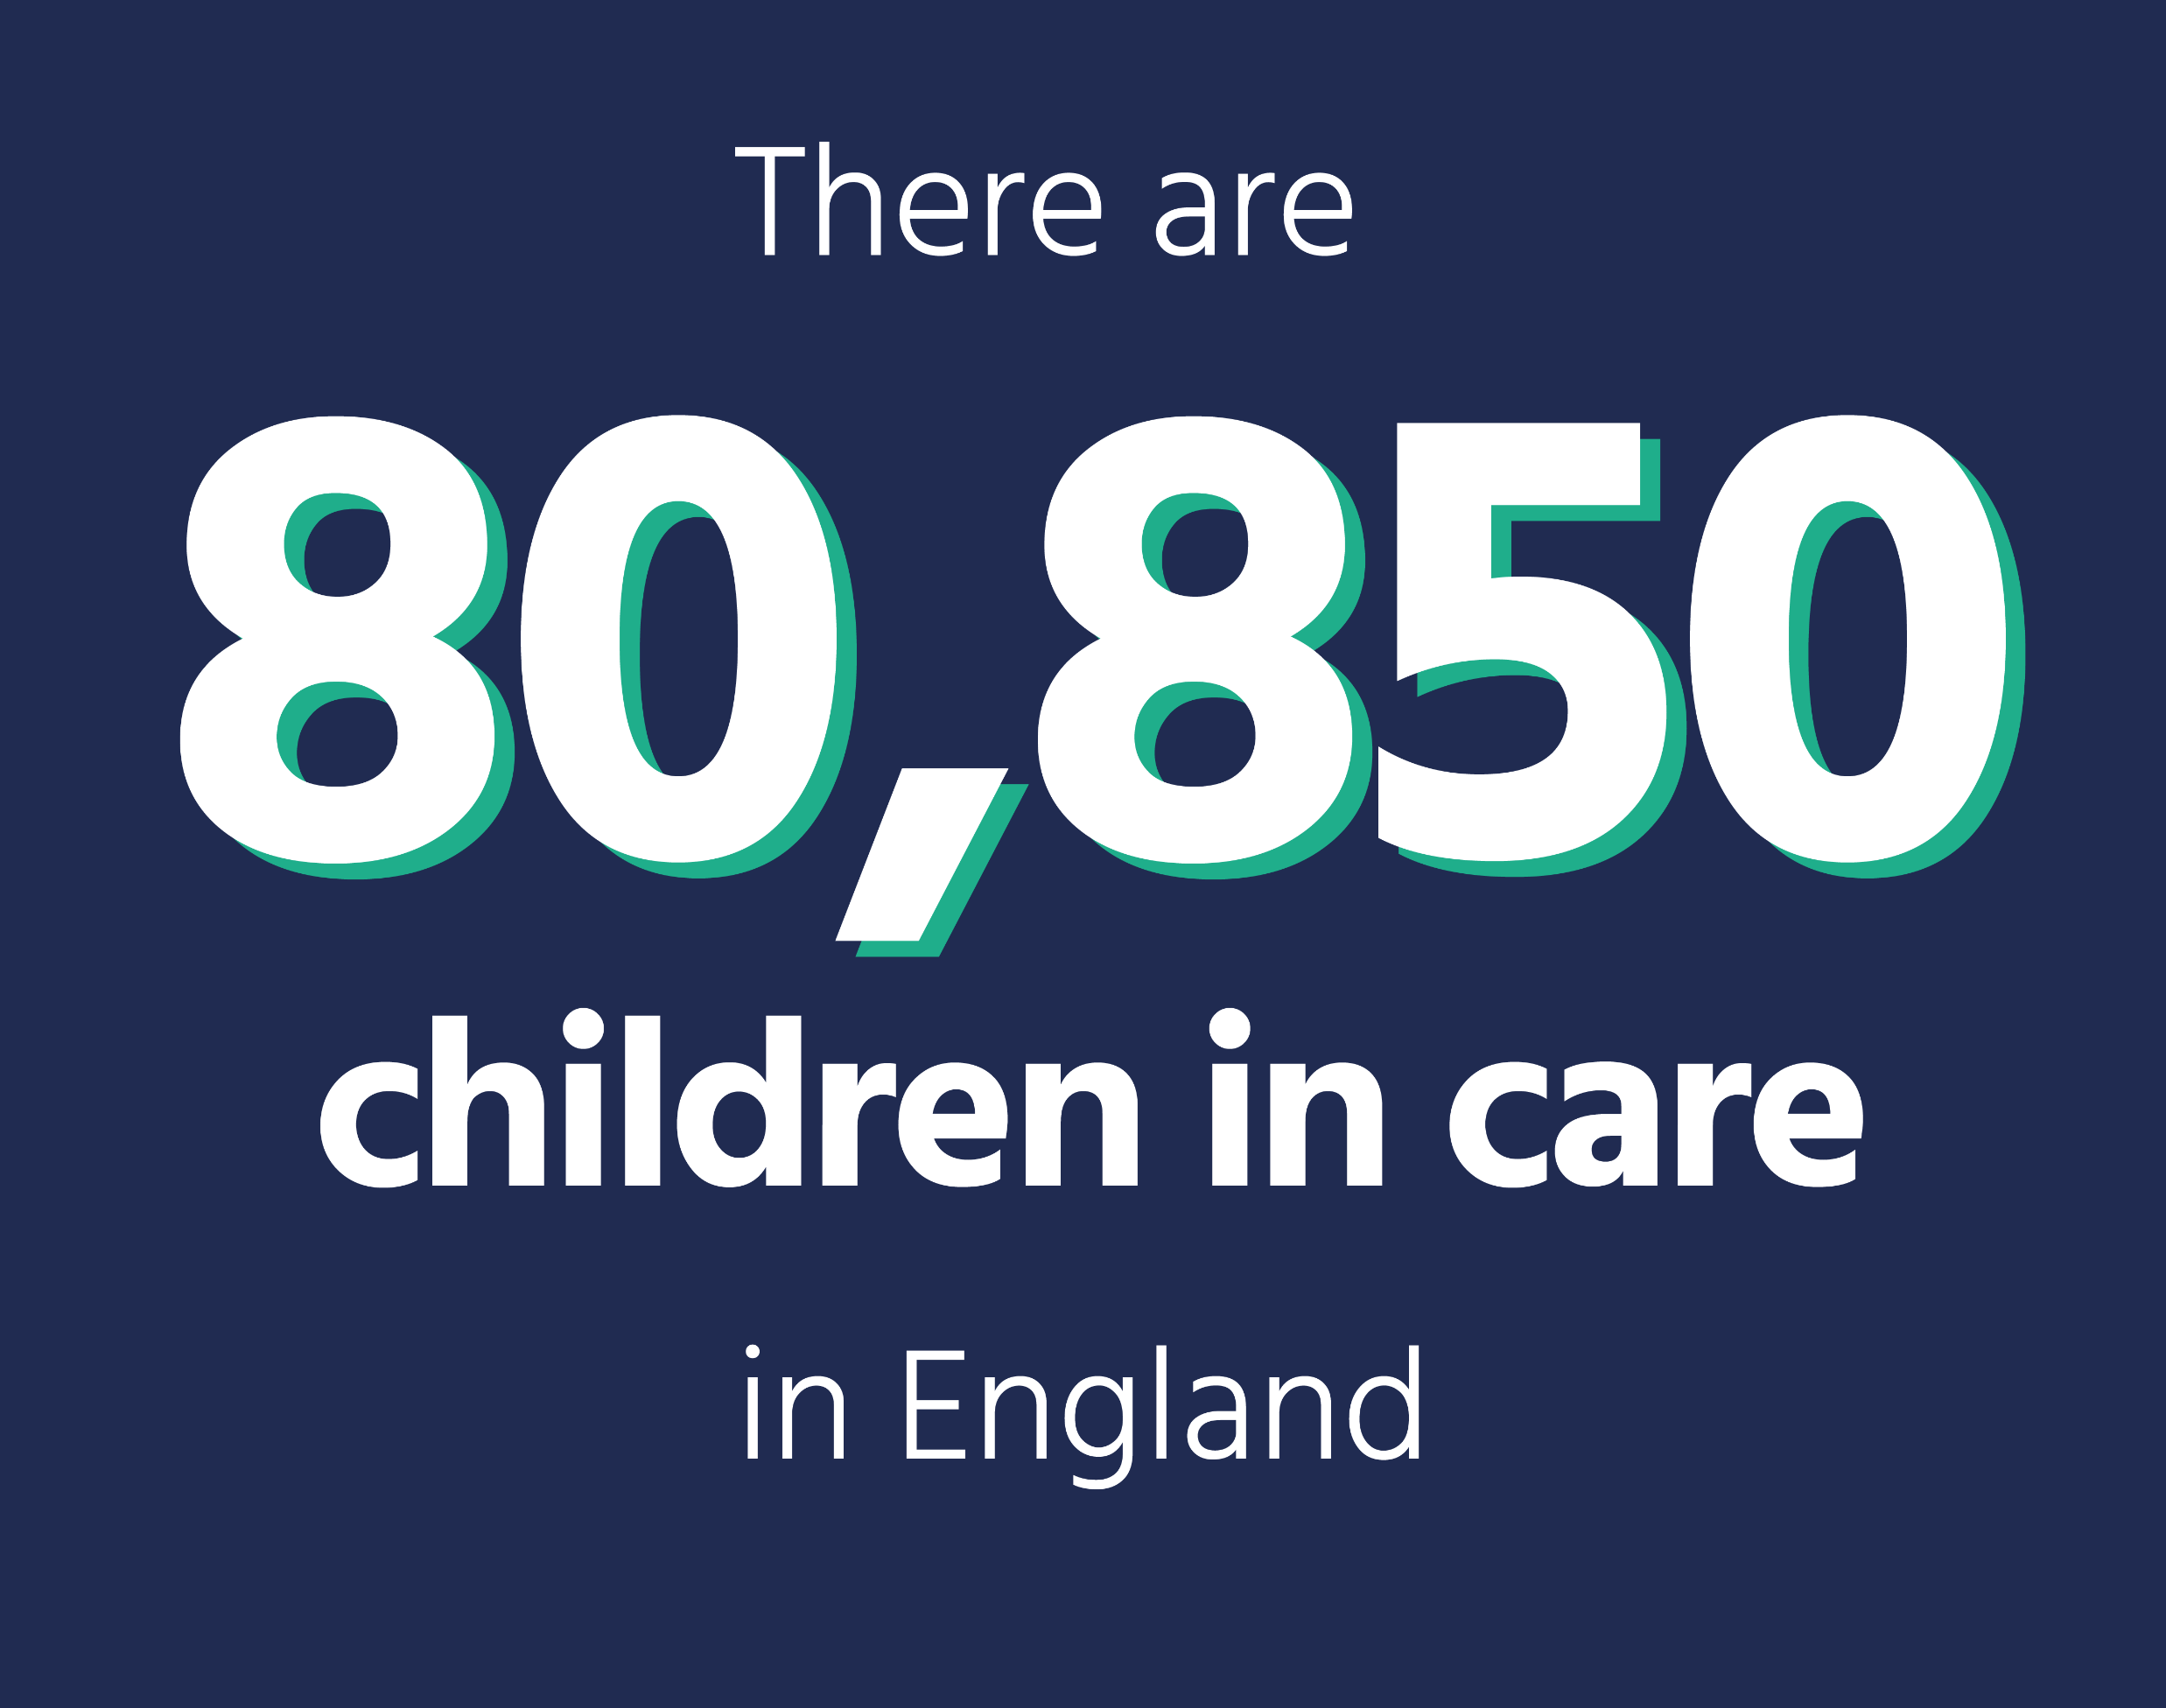
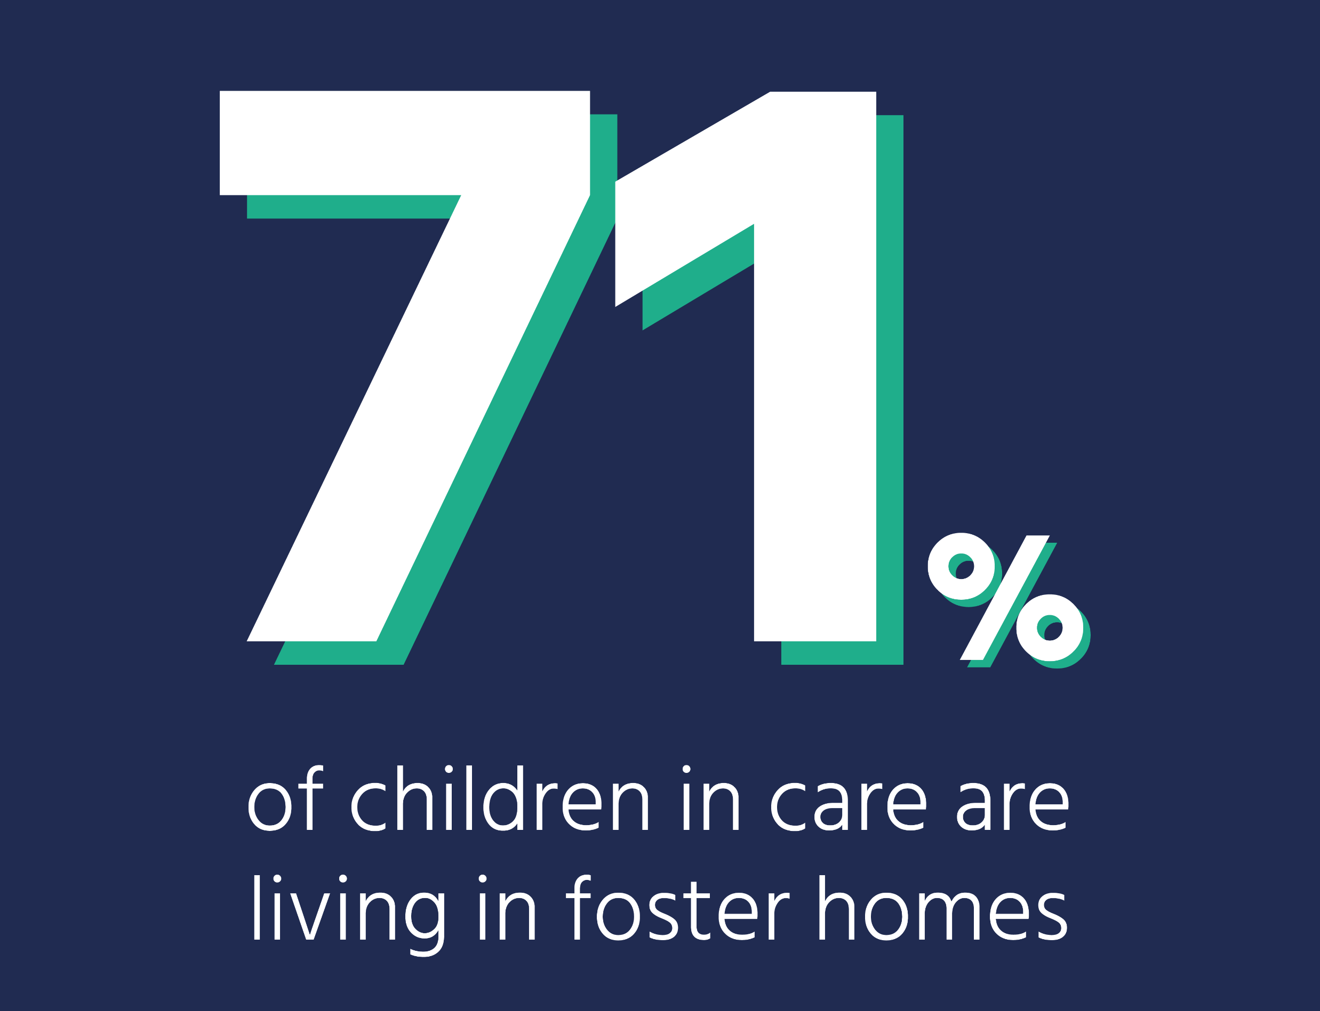
Children living away from their birth parents
Notes:
Of the over 80,000 children in care in England, around 4000 children (5%) are asylum-seekers that came to the UK without an adult.
29% of children in care said that starting their own family is something important to them, compared to 26% of children overall

Slide 10
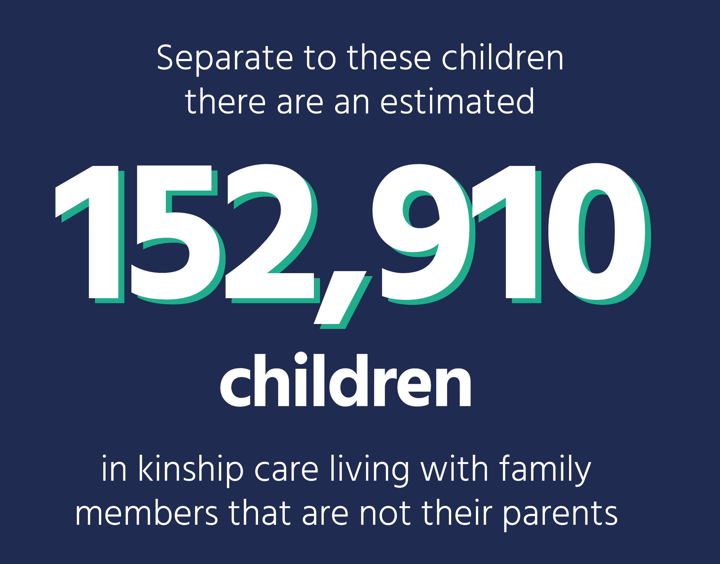
Kinship care is important
Over 150,000 children live with grandparents, aunts, uncles or other family members that are not their parents.

Slide 11
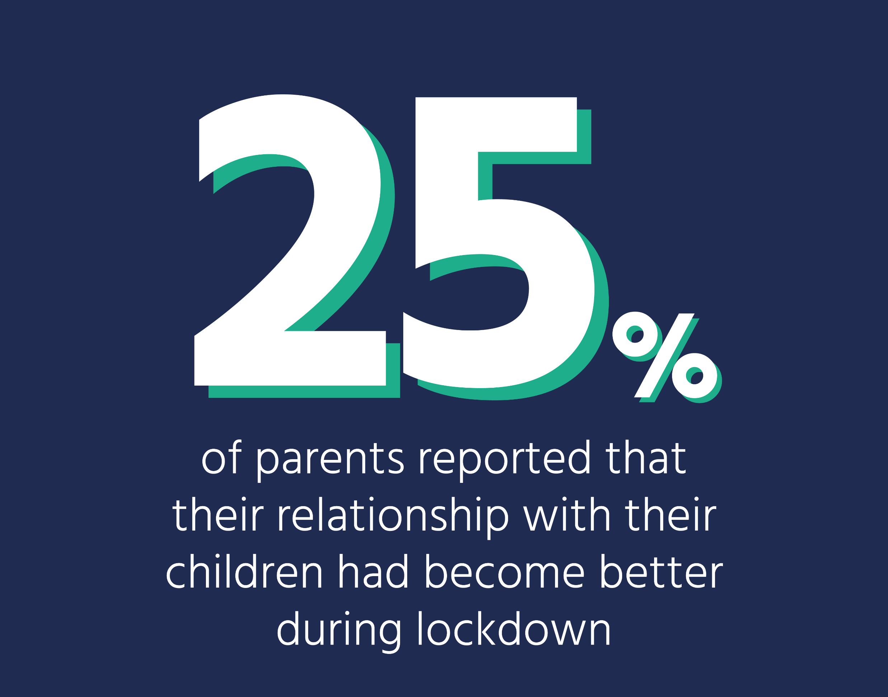
The pandemic had an impact on families across the country
The pandemic and lockdowns were hard for many of us, but also meant that many families could spend more time together.
In fact, a quarter of parents said their relationships with their children improved during lockdown.
Notes:
The amount of time fathers spent on unpaid childcare went from 47 minutes a day in 2014-2015 to 90 minutes a day during lockdown to 56 mins a day in 2022

Slide 12
Family has a ‘protective effect’ for children and parents

Slide 13
What about your family?
Notes:
Choose activities based on your class and interests.

Slide 14
Draw your family tree
I am sure that you have all seen what a family tree looks like – usually they are made up of generations of relatives.
Today I want you to think about who makes up your family, you can include anyone you want (including pets), and go back as many or a few generations as you want to.
You also don’t have to use a tree – you could use a star, some circles – whatever shapes and connections you think suit you family the best.
Think about how you might depict how often you see the, what you like doing with them, and how close you are to them.
Notes:
Purpose: Children can explore what family means to them by designing a family tree. This drawing can encourage discussions around how the children see their families, who they live with and how close they are to different members of their family.
Ask: The children to think about their family, who they consider family and how they fit together.
Classroom activity: The children don’t have to draw a family tree in the traditional sense, i.e parents, grandparents, great-grandparents. Instead, ask the children who’s who in their family. Ask them if there are people in their family who they don’t live with or whether they live in more than one home. Are there people in your family who aren’t blood relatives? How does their family fit together and how has it changed over time? The children can illustrate all of this in any way they want.
Even better if: Is this something that can be added to over time. If there is time, encourage the children to go home and speak to those they live with about who they consider family – can these people be added to their family trees?

Slide 15
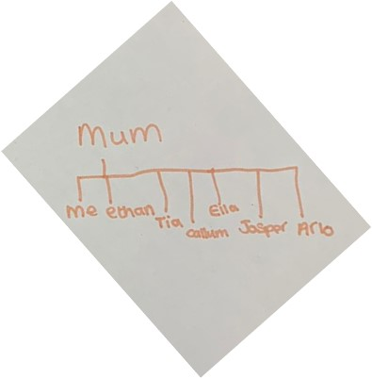
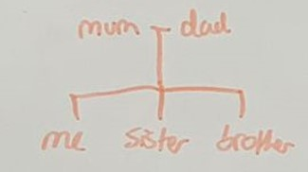
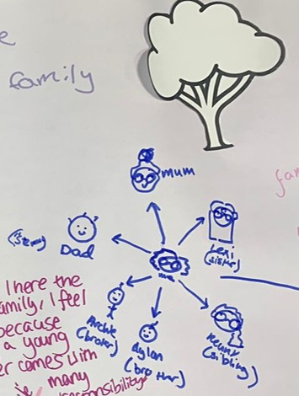
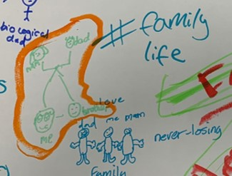
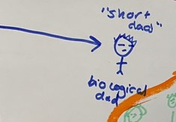
Draw your family tree…

Slide 16
Draw your family
Everyone’s family looks different – and the Children’s Commissioner wants to understand what yours looks like.
I want you to think about who you consider your family to be – there can be as many people – including pets – as you want.
Think about an activity you like to do with these family members, it could be cooking, it could be playing a game, reading or watching TV.
When you are drawing your family you could draw them doing one of the activities that you usually do together.
Make sure to label the people in your picture so we know who they are.
Take a look at some of the other examples that children have sent in.
Notes:
Purpose: This might be more suitable for younger children. This activity is designed to encourage children to think about who makes up their family and how they enjoy spending time with them.
Ask: To draw/paint who they consider family doing an activity they enjoy doing together. The activity could be anything they want/do regularly.
Classroom activity: Emphasise that everyone’s family looks different. Then encourage the children to discuss who they consider as family (they don’t have to be blood relatives) and why they consider them as family. Ask them who looks after them at home, who else to these people look after – this could be their pet. Encourage them to include people they consider family who they don’t live with. Ask the children to draw these people doing an activity they enjoy doing with them/do often.
Even better if: Ask some of the children to present their drawings, explaining the people they have drawn, the activity and why they have chosen those people/that activity.

Slide 17
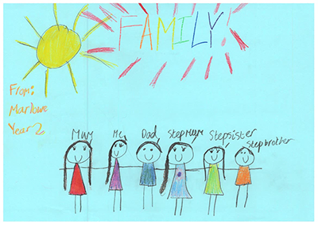
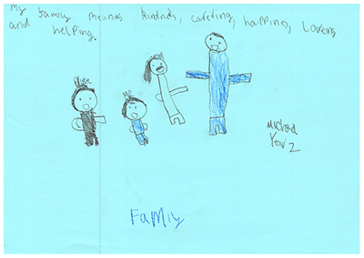
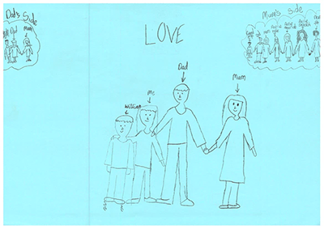
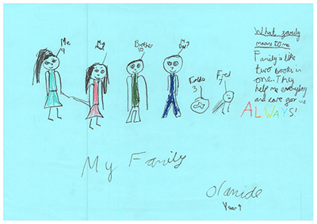
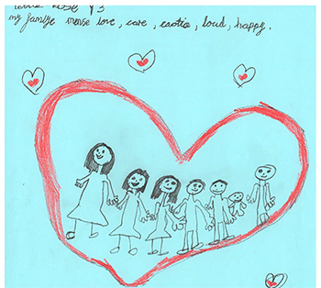
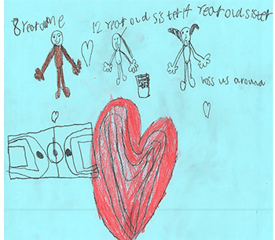
Draw your family…

Slide 18
Describe your family
Think about who is in your family – who do you consider family (it doesn’t have to be blood relatives), where do you all live and what do you enjoy doing together as a family?
Now I want you to think about whether you would prefer to write a short biography/short poem/create a collage about your family and what it means to you.
Share these with the children’s commissioner’s office if you feel like you want to!
Notes:
Purpose: Get children thinking and talking about what their family means to them
Ask: Introduce the family review and ask the children consider whether they want to write a short story/biography or poem about their family, what it means to them and what they enjoy doing together.
Classroom activity: Emphasise that everyone’s family looks different, some people might consider pets as family, some might have closer bonds to different family members such as grandparents or friends. Then encourage the children to discuss who they consider as family (they don’t have to be blood relatives) and why they consider them as family. Emphasise whoever they see as part of their family builds up their personal family network. Encourage them to include people they consider family who they don’t live with. What do the different members of their family network mean to them. What does family mean to them?
Even better if: Ask some of the class to share their work, explaining why they included certain elements, what the key message they wanted to share was.

Slide 19
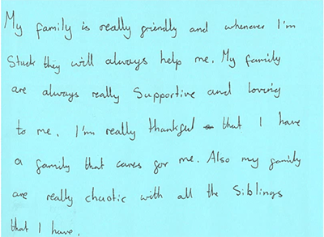
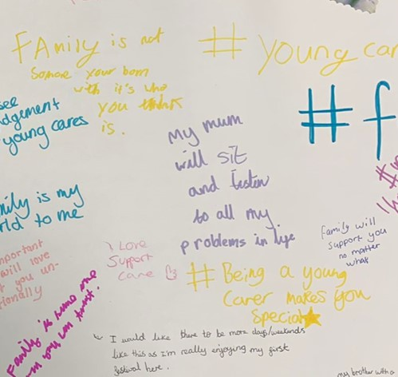
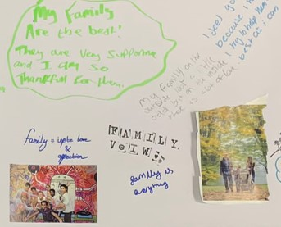
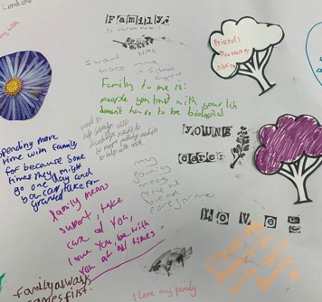
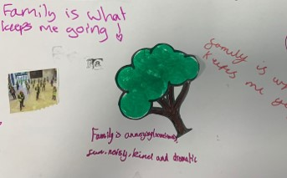
Describe your family…

Slide 20
Create your own cookbook
Think about your favourite dish – this could be something you eat together with your family all the time, something you make for special occasions or something you just love to eat
Go home this evening and find out:
[Date they will do the activity] You are going to use the information you have to design your very own class cookbook..
Think about what images you want to use – maybe you are cooking it with your family, maybe you want to display the dish alone or maybe you want to draw the person/people the dish reminds you of
Also think about a paragraph explaining why you have chosen this recipe – why do you like it, where is it from, who do you make it with/eat it with. This will be included on your recipe page.
Name of the dish
Cooking time
How many the recipe serves
Ingredients with measurements
Method
Notes:
Purpose: This will encourage children to think about what they usually eat at home, family traditions around food and family heritage. This is an opportunity for children to discuss who and how they spend time with their family. This will link nicely to the children filling out the big summer survey which asks about how they spent their summer.
Ask: The day before the lesson, ask the children to go home and think (ask their families) about the dish that is their most favourite to eat as a family. Tell them to write down the recipe as if it were going to be in a cookbook. And to write down why it is important to them. If you think some children may not have seen what a cookbook looks like then maybe bring one in as an example or pull an image of one up on the screen
Classroom activity: Ask the children to share their recipe and explain why it is their family favourite – e.g was is passed down through the generations, was it their parents’ first cooked meal? Ask the children to write a context paragraph that you usually see in cookbooks explaining why they have picked the recipe they have and what they hope other people can experience when they cook it. They can add illustrations/pictures of the dish or the process of making it.
Even better if: Create your own classroom cookbook by collating all the recipes. Maybe you could create a pdf version or a physical copy depending on resource.

Slide 21
“It’s my life” music album
Think about your favourite music artist and your favourite album
Today we are going to create your very own music album about your life.
Think about 10 songs that mean a lot to you and your family, these could be songs you always listen to or songs that remind you of them
Or
Think about 10 songs that track the timeline of your life
Now, you are going to design the album cover complete with a title and cover art
Somewhere in the cover include a paragraph on why you have chosen the songs you have and who you enjoy listening to them with
If you want – why not create a playlist of these songs and share it with your family?
Notes:
Purpose: Children might find it easier to think and talk about their family lives though music. This should encourage children to think about the music that means the most to them and their family. This should lead to discussions between you and the class about their family and what it means to them.
Ask: Ask the children to think about their own musical tastes and how it has been shaped by their childhood, their family and those around them.
Classroom activity: Ask the children to write down 10 songs. These can either be songs that describe their childhood and different ages (imagine a timeline o their lives through songs) or songs that mean the most to them and their family. Then ask the children to create a vinyl cover for their own music album complete that includes artwork and a title.
Even better if: Could these vinyl covers be displayed somewhere in the classroom?

Slide 22
Create a podcast
Think about your favourite podcast – how is it structured, what makes it interesting?
Now I want you to think about your family – who is in it, what do you think about it, how do families differ, what is important about family.
I want you to create a podcast about family and what it means to you.
Notes:
Purpose: Get children talking to their classmates in class or to their parents/carers/friends at home (people they consider family) about what family means to them
Ask: In groups get them to record their thoughts on who they consider part of their families, what activities they like doing together as a family, what family means to them – why is/isn’t it important? If over a couple of lessons could get them to record thoughts from family members/friends at home. Then come back together and edit into a podcast. Help them think about structuring the podcast – will they share the quotes from each question they asked as groups. Will they share each persons ‘interview’ separately, are there any key messages they want to convey. Could they develop it like a news piece with a narrator e.g. making a statement such as ‘most children we spoke to think of their pets as family’ followed by voice recordings of children saying who is involved in their family. Then ‘children we spoke to find family supportive’ followed by voice recordings of children saying similar things etc.
Classroom activity: Emphasise that everyone’s family looks different, some people might consider pets as family, some might have closer bonds to different family members such as grandparents or friends. Then encourage the children to discuss who they consider as family (they don’t have to be blood relatives) and why they consider them as family. Emphasise whoever they see as part of their family builds up their personal family network. Encourage them to include people they consider family who they don’t live with. What do the different members of their family network mean to them. What does family mean to them?
Even better if: Ask some of the groups to share their podcasts, explaining why they included certain elements, what the key message they wanted to share was.

Slide 23
Showcase your creativity with us!
We would love to hear from you and see what you’ve created that shows who is in your family and what family means to you. We might even share it online and on social media.
Get your teacher to email it to us…
Or share it on your schools twitter account, don’t forget to tag us @childrenscomm and use #...

Slide 24
Thank you!

