Slide 1
Information Pack

Slide 2
About Help at Hand
The Children’s Commissioner for England, Dame Rachel de Souza, has a legal duty to promote and protect the rights of children and make sure that their voices and views are heard and taken seriously.
The law says that she must have a special regard for children in care, care leavers, children living away from home and those working with children’s services and that she must provide advice, assistance and representation to children in this group. That’s where Help at Hand comes in!
Help at Hand is the Children’s Commissioner’s advice line for children and young people in care, care leavers, children living away from home and those working with children’s services. We also provide advice to professionals on behalf of these children but always aim to include the young person wherever possible.
Our advice line is independent of Government and is here to make sure that vulnerable young people know their rights and that their rights are upheld by those who make decisions about their lives.

Slide 3
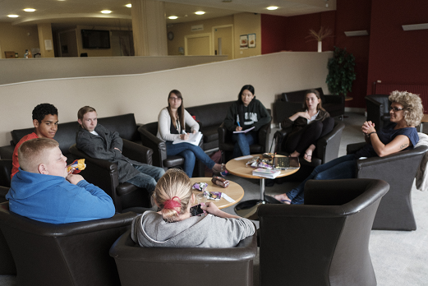
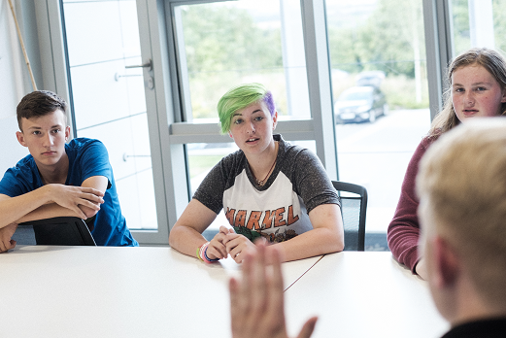
How we developed Help at Hand
Help at Hand is the Children’s Commissioner’s advice line. We created the Help at Hand brand with the input and creative energy of a team of young people with care experience. They have helped to steer the name, visual style and tone of voice through creative workshops and online feedback. This collaborative approach with young people is what Help at Hand is all about. Our name, materials and look and feel are all designed to communicate who we are and to ensure that young people feel confident to get in touch with us.

Slide 4
What we do
Advice where knowledge is missing
Assistance where there is insufficient support
Representation when someone needs to listen
Our mission is for all children in care, care leavers, those living way from home or working with children’s services receive the highest quality care possible. We achieve this through providing:

Slide 5
How it works: 1
Need help?
If you’re a young person in care, a care leaver, working with children’s services or living away from home and need advice or support – we’re here to help.
We offer support
and advice if:
you want to make a complaint / you’re not getting the right support / you’re worried about placement moves, housing, finances or your future / you’re not being heard / you feel unsafe

Slide 6
How it works: 2
Get in touch
We’ll listen and ask questions to
understand your situation and views.
It’s confidential and free!
You can reach us on
0800 528 0731
or help.team@childrenscommissioner.gov.uk
between 9am and 5pm,
Monday to Friday

Slide 7
How it works: 3
We’ll take action
We’ll give you advice and support.
We’ll use our influence to make sure your rights are upheld.
We’ll do this by:
offering advice when you need information
assistance when you need support
representation when you need someone to listen

Slide 8
Who we are
Clear and approachable
“I feel like I understand what the service is about and I know they’re here to help”
Reliable and supportive
“I feel like they the service is there for me when I need them”
Informative and empowering
“I feel like I’ve been given the right information and advice to take charge of my situation”
Influential and expert
“I feel like that the service has the influence and expertise to make things happen”

Slide 9
Key messages
1. We’re a young people friendly service
2. We’re about influence, change and children’s voices
3. We’re responsive to issues that matter to children and young people
4. We’re a service that is quick, responsive and supportive
5. We’re led by young people’s views, wishes and feelings
6. We’re about challenging the establishment
These are the main messages we hope to get across to children, young people and professionals who use the service.

Slide 10
Our promise to children and young people
We promise to listen to young people and empower them to know their rights and entitlements. We promise to challenge others and to stand up for children and young people.
We are committed to delivering advice, assistance and representation to young people across the UK. What we do can be articulated through our promise to young people, ensuring we are accountable for delivering the best quality services to those that need them most.

Slide 11
How we want young people to feel using the service
We want all young people to feel that they are listened to and respected.
We want all young people to feel that decisions have been made based on their wishes.

Slide 12
Our Values
Our values are a key part of Help at Hand. They capture what’s important to us and shape what we do and say as a service.
We are approachable
We are respectful
We are supportive
We are responsive
We are reliable
We are empowering

Slide 13
Our vision for the future
Our vision is that all children in care, care leavers, those living away from home or working with children’s services have access to their rights and entitlements and have their voices heard.
A vision is important in ensuring that everything we do is helping us drive towards a bigger goal and ambition.

Slide 14
Our beliefs
We believe children and young people have rights, no matter what. We believe that their voices and opinions matter and should be respected.
Underpinning our vision are two core beliefs. These beliefs are at the forefront of everything we do, from our work giving advice to young people who most need it, to influencing policy at a national level.

Slide 15
What young people say
“Just that letter had some influence because it made stuff happen. If something simple like that can happen from a letter then they can really help a lot of people.”
“[Staff at the Help at Hand service] have been really helpful to me, it has been insurmountable help, it has been really life changing stuff.”
“Without [Help at Hand] I wouldn’t have made it this far. Thank you for believing me and getting me the support I needed!”

Slide 16
What professionals say
“They were very helpful. They gave me good advice, spoke to the young person themselves and were quickly on the case writing to the local authorities involved. They didn’t get dragged into one particular side and kept me in touch with what was happening.” Professional (advocate) who used the service

Slide 17
Sample materials: posters, flyers, wallet cards and stickers

Slide 18
If you’d like more information about Help at Hand or would like materials to display or distribute,
please get in touch with:
Beatrice Longmore
Head of Advice
Help at Hand
Beatrice.Longmore@childrenscommissioner.gov.uk
Help at Hand | The Children’s Commissioner

