Slide 1
Coming up this week…
This session will cover:
Thought of the Week: Will you take part in the largest youth survey?
Be informed: Who is the Children’s Commissioner?
Be curious: What is The Big Ask?
Be heard: How can you get involved?
Videos:
Videos can be accessed by clicking the image provided, or by alternative video links found in the notes section of each slide.
Please Note:
For more information and resources surrounding The Big Ask, please click here.
Notes:
The Big Ask: https://childrenscommissioner.gov.uk/thebigask/
Images
iStock
https://www.childrenscommissioner.gov.uk/

Slide 2
Thought of the Week…
Will you take part in The Big Ask?
Notes:
Images
iStock

Slide 3
Be informed: Who is the Children’s Commissioner?
Every child in the UK has rights. There are more than 40 of these, and it is the job of all adults in the UK (including the Government, teachers & parents) to make sure that they are followed.
Do you know your rights?
Take a look at these statements. Put your hand up for the ones you think are rights.
Every child should receive a free education that prepares you for life after school.
Every child should have a gaming device, such as a Playstation or Xbox.
Every child should be able follow their own religion or beliefs and have these respected by others.
Every child has the right not to be discriminated against for any reason.
Every child has the right to go on holiday at least once every year.
Every child has the right to give their opinion and be listened to.
Notes:
Images
Icons8
References:
1) https://plan-international.org/sites/default/files/field/field_document/child-friendly_crc_poster_a4_-_final_-_english.pdf

Slide 4
Be informed: Who is the Children’s Commissioner?
Four of the statements you read were rights (there are over 40 in total):
The remaining two were not rights…
Every child should receive a free education that prepares you for life after school.
Every child should have a gaming device, such as a Playstation or Xbox.
Every child should be able follow their own religion or beliefs and have these respected by others.
Every child has the right to go on holiday at least once every year.
Every child has the right to give their opinion and be listened to.
However, children do have the right to play, to rest and lead healthy lives!
Every child has the right not to be discriminated against for any reason.
Challenge:
What other rights do you think that all children should have?
Notes:
Images
Icons8
References:
https://plan-international.org/sites/default/files/field/field_document/child-friendly_crc_poster_a4_-_final_-_english.pdf

Slide 5
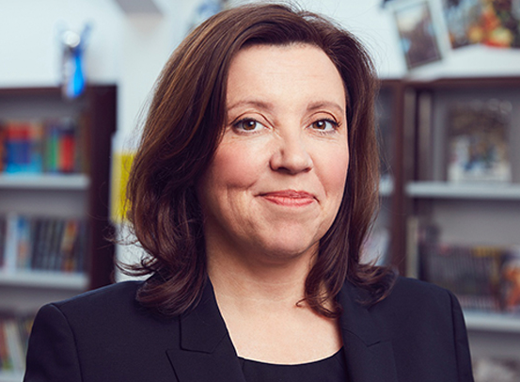
Be informed: Who is the Children’s Commissioner?
0:00-3:07
This is Dame Rachel Mary de Souza. She is the new Children’s Commissioner here in England.
It’s her job to make sure that children’s rights are protected. She speaks up for young people to make sure that the Government and other important people listen to what you have to say.
Watch (3 mins)
Click the image to hear from Dame Rachel about her job as the Children’s Commissioner.
Did you know? Before she became the Children’s Commissioner, Dame Rachel was a Headteacher.
https://safeshare.tv/x/rHV4b5iwwmk
Notes:
Alternative video link: https://www.youtube.com/watch?v=rHV4b5iwwmk (until 3:07)
Images:
1) Courtesy of The Children’s Commissioner

Slide 6
Be curious: What is The Big Ask?
To help the Children’s Commissioner understand what you are thinking and feeling, Dame Rachel is asking for every young person in England to answer a questionnaire.
As you may have guessed, this questionnaire is called The Big Ask.
The Big Ask will be the largest ever survey of young people in England. It is only a short survey, and it will ask you…
How old you are
What makes you happy
What worries you
Who you live with
Who helps you
Notes:
Images:
1. Icons8
2. iStock
3. Children’s Commissioner

Slide 7
Be curious: What is The Big Ask?
All the answers that you give in the survey are confidential, so they won’t be shared with other people.
The survey won’t ask for your name or your phone number either, and you don’t have to answer a question if you don’t want to.
The Children’s Commissioner will collate (collect) all the answers and take them to the Government, to show them what young people think and to highlight what you want to see in future.
Notes:
Images
Pixabay
Icons8
Children’s Commissioner

Slide 8
Be heard: How can you get involved?
0:00-2:02
Watch (2 mins)
Click the image to hear more about The Big Ask from Dame Rachel, and from someone else you might recognise…
You can complete it at any time from 19th April until the 19th May. Each person can only complete the survey once.
To take the survey, you will need a computer, tablet or phone and access to the internet.
You can find the survey by clicking on any of these icons, or by searching for “The Big Ask” online.
And if you finish the questionnaire early, look at the extra links at the end!
https://safeshare.tv/x/ss6079584372fe7
https://www.childrenscommissioner.gov.uk/thebigask/
Notes:
Alternative video link: https://www.youtube.com/watch?v=rHV4b5iwwmk (from 3:07)
Images
Icons8
Children’s Commissioner

